Slide 1
Good writing in a nutshell

Slide 2
Agenda
What is plain English ?
Writing a readable sentence
Organization
Layout
A model for writing

Slide 3
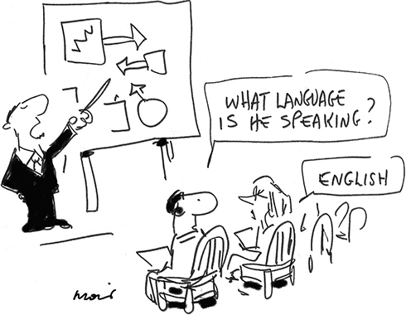
What is plain English ?
Plain English, to put simply, is a way of expressing your ideas clearly in writing and speaking.
We think of it as having three parts.
Style - how to write clear
Organization - start with your main point
Layout – use white space techniques.

Slide 4

Example time !
Bad way
Each application shall be supported by a comprehensive letter of explanation in duplicate. This letter shall be supported by a comprehensive letter of explanation in duplicate. This letter shall set forth all the facts required to present to this office a complete disclosure of the transaction.
Good way
You must send us the following:
One copy of your application
Two copies of a letter explaining the complete details of your transaction

Slide 5

Conclusion time !
Psycholinguists have learned that we all take longer to read less familiar words (like commence) than familiar ones (like begin). The difference is only a few milliseconds in time, but a lot less strain on the short term memory
Many large organizations today are endorsing plain English:
Private business
Federal agencies
U.S military
Scientific and engineering organizations
And even lawyers

Slide 6

Writing a readable sentence.
Write more the way you talk, with ordinary words, a variety of punctuation, personal pronouns and contractions.
Talk to your reader
Talk on paper
Don’t be afraid to keep it simple
Write the way you talk
Inspire yourself from magazines, newspapers, books, etc.

Slide 7
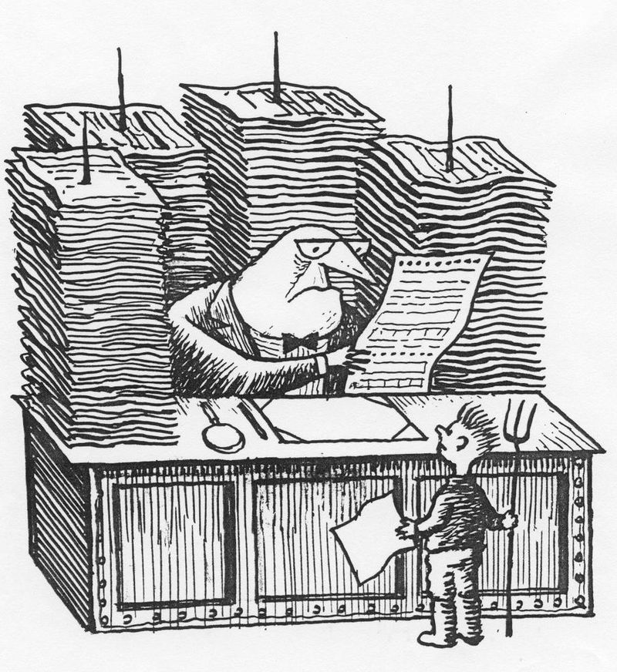
Don’t be a bureaucratic writer
Use ordinary words
Use a variety of punctuation
Use more personal pronouns
Use contractions

Slide 8


Slide 9
Ordinary words
Don’t Do
initiate, commence begin
terminate end
utilize use
because of the fact that since(because)
call your attention to the fact that remind you
for the period of for
in many cases often
the fact that he had not succeeded his failure

Slide 10
Example time !
Bad way
Subsequent to the passage of subject legislation, it is incumbent upon you to advise your organization to comply with it.
Good way
After the law passes, you must tell your people to comply with it.

Slide 11
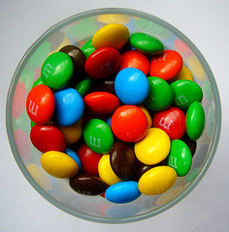
Variety of punctuation
Too often business writers use only periods and commas.
Do not speak in a monotone on paper
Do not make your audience try to figure out what is important in your sentence and what should be carried over to the next

Slide 12


Slide 13
Example time !
Bad way
The main point is that the defective computer disks are not responsibility of the manufacturer, as we first suspected, but of the wholesaler, who stored them at a 130 degree temperature.
Good way
Just who’s responsible for the defective computer disks? Is it the manufacturer as we first suspected ?
No. the wholesaler is responsible, he stored them at 130 degree temperature.

Slide 14

More personal pronouns
Many of us learned at some time not to use personal pronouns. This idea come partly from the outdated notion that important business writing must be formal
But the notion of what makes good writing s changing, and a more personal, informal tone is gaining wide acceptance for all kind of writing.

Slide 15
Example time !
Old way
The monitor must be first turned on and then the computer must be turned on. A menu with the..
New way
First, turn on the monitor. Then turn on the computer.
You’ll see a menu with…

Slide 16
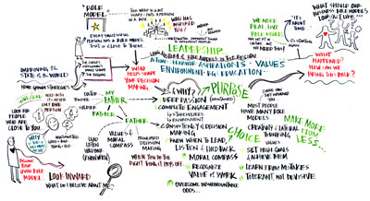
Layout
The look of a page is important.
Show the reader the underlying structure of your writing by using headings, lists and other good techniques of white space.
Show the reader your organization and helps him be organized.
There are three layout techniques:
Use short paragraphs
Use headings
Use bullets and other lists

Slide 17
Example time !
Bad way
Three satellites are in geosynchronous orbit at 23,000 miles over the equator: Satellite I is at 55 degrees west longitude, Satellite II is at 70 degrees west longitude, and Satellite III is at 140 degrees west longitude.
Good way
Three satellites are in geosynchronous orbit at 23,000 miles over the equator:
Satellite I at 55 degrees west longitude.
Satellite II is at 70 degrees west longitude.
Satellite III is at 140 degrees west longitude.

Slide 18

Tip time !
Never begin a sentence with and or but.
Never use contractions.
Never refer to the reader as you.
Never use the first person pronoun I.
Never end a sentence with a preposition.
Never split an infinitive.
Never write a paragraph containing only a single sentence.

Slide 19

Organization
Start with the main point.
Be sure your lists are parallel.
Use creative layout for your words.
Use a highlighted figure.
Include the object itself.
Use a diagram

Slide 20
Tip time !
Prewriting
Think hard
Write an outline
Writing
Follow your outline
Write quickly without worrying about revisions.
Rewriting
Make sure you followed your outline
Fix any errors

Slide 21
Conclusion time !
At times plain English does approach art. A clean, straightforward document can be beautiful in its simplicity and efficiency.

Slide 22
Thank you
Papuc Eugen
AM Engineer

